Slide 1
Section 6.2
Sample Spaces for Independent Events

Slide 2
What are Independent Events?
Two events are considered “independent” if they do not affect each other
For instance, what you eat for dinner tonight will not affect the weather tomorrow → two independent events
In mathematics, when we flip a coin, the outcome of each flip is independent of the one before/after it
Likewise, when we roll a die (dice) or spin a spinner, each roll/spin is independent
Note: if a dice favors one side more than others, then that dice is considered as “bias”

Slide 3
Practice: Given each pair of events below, indicate whether if they are independent or not:
a) Flipping a coin and rolling a die
b) Drawing a card from a deck, keep it, and then draw the next card. Will the first draw affect the second draw?
c) Flipping a coin 6 times. The first 5 times were heads. Will this affect the outcome of the 6th flip?
d) A basketball player shooting a free throw. Is each free throw independent?
Each flip is independent!
Not independent because keeping the 1st card will affect the
outcome of the second draw
Independent b/c the outcomes of the first 5 flips do not affect
the next one
This one is arguably not independent b/c if the player misses
the first shot, he will naturally adjust to improve his next shot

Slide 4
Sample space with 2 or More Events
A sample space is a list of all the possible outcomes
When finding the sample space, draw a tree diagram to illustrate each outcome
Ex: A Spinner and die is rolled. If the spinner hits an even number then the die is rolled. If odd, spin again. Draw a sample space for this experiment:
Spinner
Even: 2,4
Odd: 1,3
1
2
3
4
5
6
1
2
3
4
The sample
space of this
experiment is:

Slide 5
Practice: Given each event, find the sample space by drawing a tree diagram:
a) A coin is tossed 3 times
b) One president and one captain is to be selected from a group of 4 people: Amy, Brad, Chris, and Don
1st Coin
A
B
C
D
Heads
Tails
Heads
Tails
Heads
Tails
B
C
D
A
C
D
A
B
D
A
B
C
The first person will be the president
The second will be the captain
H
T
H
T
H
T
H
T
Your sample space will be:
The sample
space is:

Slide 6
The Fundamental Counting Principle
One way to count the number of outcomes is by using the “Fundamental Counting Principle”
If we have “x” number of ways to do the first task and “y” number of ways to do the second task, then there are “x” times “y” ways to do both tasks.
If there are several different tasks:
“A” – Number of ways to do the first task
“B” – Number of ways to do the second task
“C” – Number of ways to do the third task.... and so on
The total number of different ways to do all the task together will be:
© Copyright all rights reserved to Homework depot: www.BCMath.ca

Slide 7

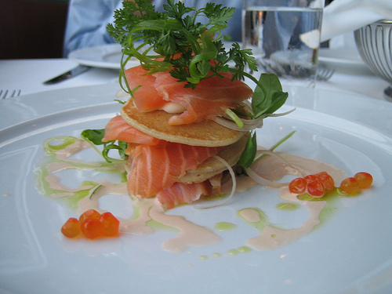
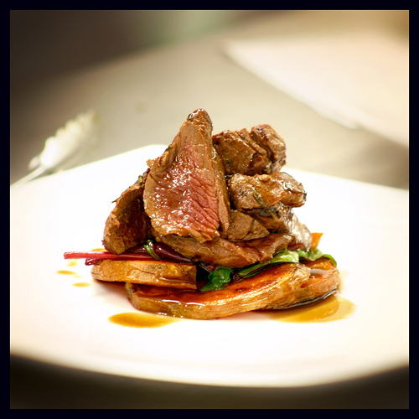
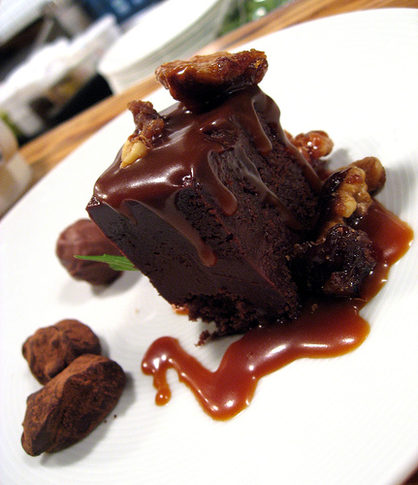
Ex: how many different 3 course meals can you order at the salmon house if there are 3 different appetizers, 4 main course, and 3 different desserts.
There are three different categories: Appetizers, Mains, and Desserts
Use the Fundamental Counting Principles to count how many different
meals are possible
Multiply the number of choices in each
category
© Copyright all rights reserved to Homework depot: www.BCMath.ca

Slide 8
Practice: How many combinations can you make if there are 10 different icings, 16 different ice-creams, and 10 different cones.
FCP: Multiply the number of choices for each category
© Copyright all rights reserved to Homework depot: www.BCMath.ca

Slide 9

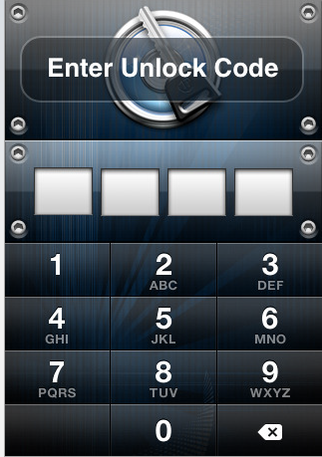
Ex: The Iphone has a 4 digit numerical password. What is the total number of different passwords that are possible.
1st method:
Count all the possible
outcomes from the
smallest to the largest
number
2nd method:
Multiply the number of
options for each digit
There are 10 choices from each digit:
There are 10 thousand
different numbers possible
In total, there are:
© Copyright all rights reserved to Homework depot: www.BCMath.ca

Slide 10
Homework:
P424 #4 to 16

